Slide 1
Tricks of the Trade: From Loop Transformations to Automatic Optimization
By: Maurice Peemen
5KK73 Embedded Computer Architecture
Notes:
Introduce the topic: loops and neste loops, optimize their behavior to better match platform or processor architecture. To improve performance (execution time or/and energy). Finally how to automate these processes

Slide 2
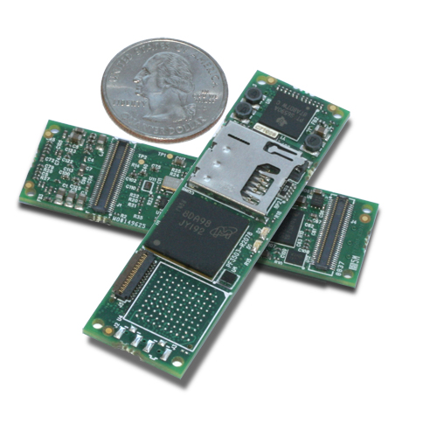
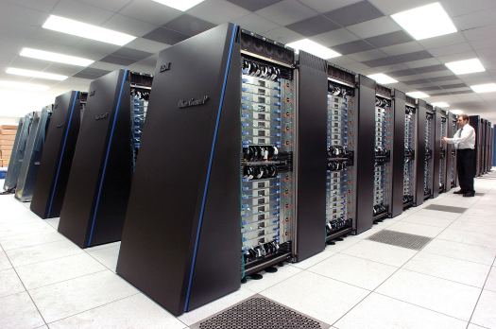
Application Excecution Time
High performance computing
Embedded computing
Small portions of the code dominate execution time
Hot spots
Loops
Improve the small part
Loop Transformations
for(i=0; i<N; i++){
for(j=0; j<N; j++){
for(k=0; k<N; k++)
c[i][j] += a[i][k] * b[k][j];
}}

Slide 3
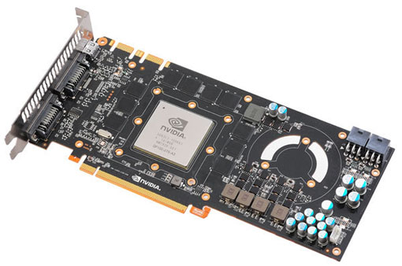
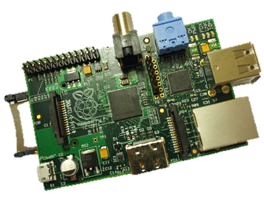
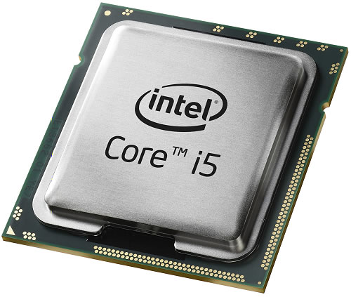
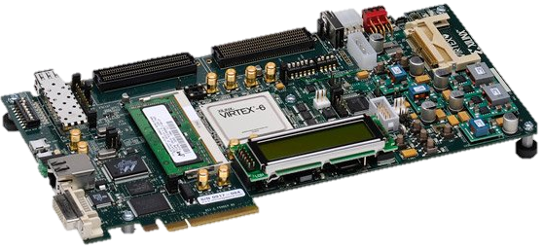
Loop Transformations
Can help you in many compute domains
Convert Loops to
GPU Threads
Embedded Devices
Fine-tune for architecture
CPU Code
Parallelism
Memory Hierarchy
HLS languages for HW

Slide 4
Loop Transformation Classes
Data-Flow-Based Transformations
Iteration Reordering Transformations
Loop Restructuring Transformations

Slide 5
Data-Flow-Based Transformations
Can be very useful:
Simple compiler
Simple architecture
No Hardware Multiplier
No Out-Of-Order Superscalar
No Speculative Branch Prediction
If you are in a hurry and missing a few percent
These are the easy tricks
To get ready for the more difficult ones ☺
* Examples are from: D.F. Bacon, S.L. Graham, and O.J. Sharp, Compiler transformations for high-performance computing. ACM Comput. Surv. 26, (1994)

Slide 6
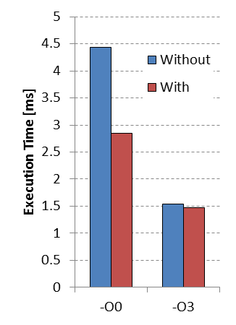
Loop-Based Strength Reduction
Replace an expensive operation
Can be multiplication, especially for embedded cores
No HW multiplier, e.g. MicroBlaze
An optimizing compiler can help
c=3;
T=0;
for(i=0; i<N; i++){
a[i] = a[i] + T;
T = T + c;
}
c=3;
for(i=0; i<N; i++){
a[i] = a[i] + i*c;
}

Slide 7
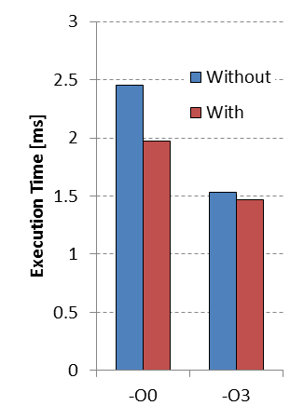
Induction Variable Elimination
Induction variable?
Compute loop exit conditions
Compute memory addresses
Given a known final value and relation to addresses
Possible to eliminate index calculations
Again an optimizing compiler can help
A = &a[0];
T = &a[0] + N;
while(A<T){
*A = *A + c;
A++;
}
for(i=0; i<N; i++){
a[i] = a[i] + c;
}
Notes:
Performing the control of a loop is basically overhead. I refer to the increment of i and the compare of i<N to check if the exit condition is not met.
With induction variable elimination we can reduce this overhead.

Slide 8
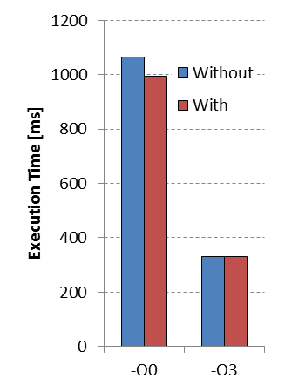
Loop-Invariant Code Motion
Index of c[] does not change
Move one loop up and store in register
Reuse it over iterations of inner loop
Most compilers can perform this
Example is similar to Scalar Replacement Transformation
for(i=0; i<N; i++){
T=c[i];
for(j=0; j<N; j++){
a[i][j]=b[j][i]+T;
}
}
for(i=0; i<N; i++){
for(j=0; j<N; j++){
a[i][j]=b[j][i]+c[i];
}
}

Slide 9
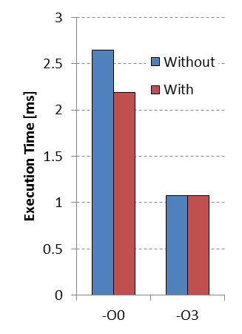
Loop Unswitching
Conditional execution in body
Speculative branch prediction helps but
This branch is loop invariant code
Move it outside the loop
Each execution path independent loops
Increases code size
if(x<7){
for(i=0; i<N; i++){
a[i]=b[i];
a[i]+=5;
}
}
else{
for(i=0; i<N; i++){
a[i]=b[i];
}
}
for(i=0; i<N; i++){
a[i] = b[i];
if(x<7){a[i]+=5;}
}

Slide 10

This is only the start
“You take the blue pill - the story ends, you wake up in your bed and believe whatever you want to believe. You take the red pill - you stay in Wonderland and I show you how deep the rabbit-hole goes.”
Morpheus, The Matrix (1999)

Slide 11
Loop Transformation Classes
Data-Flow-Based Transformations
Iteration Reordering Transformations
Loop Restructuring Transformations

Slide 12
Iteration Reordering Transformations
Change the relative ordering
Expose parallelism by altering dependencies
Improve locality by matching with a memory hierarchy
We need more theory to understand these
Or combine the tricks to form a methodology
Normal compilers don’t help you with this
Only state-of-the-art compilers can help
Often research compilers ;)
*Based on:
M. Wolf, M. Lam, A Data Locality Optimizing Algorithm. ACM SIGPLAN, PLDI (1991)

Slide 13
Loop representation as Iteration Space
for(i=0; i<N; i++){
for(j=0; j<N; j++){
A[i][j] = B[j][i];
Each position represents an iteration

Slide 14
Visitation order in Iteration Space
for(i=0; i<N; i++){
for(j=0; j<N; j++){
A[i][j] = B[j][i];
Iteration space is not data space

Slide 15
But we don’t have to be regular
A[j][j] = B[j][i];
But order can have huge impact
Memory Hierarchy
E.g. Reuse of data
Parallelism
Loop or control overhead

Slide 16
Types of data reuse
Assumptions:
1. Memory layout row mayor
2.Cache line size=4 elements
for i := 0 to 2
for j := 0 to 100
A[i][j] = B[j+1][0] + B[j][0];
Notes:
Spatial reuse = reuse of neighboring values in cache lines; Temporal reuse = Single value reused at different moment in time;
Group reuse = multiple memory references in the loop body point to the same memory location at different iteration values (temporal) or they point to neighboring values (spatial)

Slide 17
Types of data reuse
for i := 0 to 2
for j := 0 to 100
A[i][j] = B[j+1][0] + B[j][0];
Notes:
Spatial reuse = reuse of neighboring values in cache lines; Temporal reuse = Single value reused at different moment in time;
Group reuse = multiple memory references in the loop body point to the same memory location at different iteration values (temporal) or they point to neighboring values (spatial)

Slide 18
When do cache misses occur?
for(i=0; i<N; i++){
for(j=0; j<N; j++){
A[i][j] = B[j][i];

Slide 19
Optimize array accesses for memory hierarchy
Solve the following questions?
When do misses occur?
Use “locality analysis”
Is it possible to change iteration order to produce better behavior?
Evaluate the cost of various alternatives
Does the new ordering produce correct results?
Use “dependence analysis”
Notes:
Introduce theory for memory hierarchy optimization

Slide 20
Different Reordering Transformations
Loop Interchange
Tiling
Skewing
Loop Reversal
Can improve locality
Can enable above

Slide 21
Loop Interchange or Loop Permutation
for(i=0; i<N; i++){ for(j=0; j<N; j++){
for(j=0; j<N; j++){ for(i=0; i<N; i++){
A[j][i] = i*j; A[j][i] = i*j;
N is large with respect to cache size
Normal compilers will not help you!
Notes:
Example to demonstrate the possible locality increase due to interchange

Slide 22
Tiling the Iteration Order
Result in Iteration Space
for(jj=0; jj<N; jj+=Tj){
for(i=0; i<N; i++){ for(i=0; i<N; i++){
for(j=0; j<N; j++){ for(j=jj; j<jj+Tj; j++){
f(A[i],A[j]); f(A[i],A[j]);
Notes:
Example to show the potential locality increase due to tiling

Slide 23
Cache Effects of Tiling
for(jj=0; jj<N; jj+=Tj){
for(i=0; i<N; i++){ for(i=0; i<N; i++){
for(j=0; j<N; j++){ for(j=jj; j<jj+Tj; j++){
f(A[i],A[j]); f(A[i],A[j]);

Slide 24
Is this always possible?
No, dependencies can prevent transformations
Interchange and Tiling is not always valid!
Example Interchange
Spatial locality
Dependency (1,-1)
Should be lexicographically correct
for(i=1; i<N; i++){
for(j=0; j<N; j++){
a[j][i] = a[j+1][i-1] + 1;
}
}

Slide 25
Lexicographical ordering
Each iteration is a node identified by its index vector: p = (p₁, p₂, …, p_{n})
Iterations are executed in lexicographic order
For p = (p₁, p₂, …, p_{n}) and q = (q₁, q₂, …, q_{n})
p is lexicographically greater than q written as p q
Therefore iteration p must be executed after q
Example:
(1,1,1), (1,1,2), (1,1,3), …,
(1,2,1), (1,2,2), (1,2,3), …,
…,
(2,1,1), (2,1,2), (2,1,3), …,
(1,2,1) (1,1,2), (1,4,2) (2,1,1)
A little quiz?
Notes:
Lexicographical ordering introduced this will be used during the dependency analysis later on.

Slide 26
Dependence vectors
Dependence vector in an n-nested loop is denoted as a vector: d = (d₁, d₂, …, d_{n})
A single dependence vector represents a set of distance vectors
A distance vector defines a distance in the iteration space
Distance vector is difference between target and source iterations:
d = I_{T} – I_{S}
The distance of the dependence is:
I_{S} + d = I_{T}
Notes:
Dependence distance introduced. Not always possible can also be a direction vector.

Slide 27
Example of dependence vector
A_{2,0}= =A_{2,0}
B_{2,1}= =B_{2,0}
C_{3,0}= =C_{2,1}
A_{2,1}= =A_{2,1}
B_{2,2}= =B_{2,1}
C_{3,1}= =C_{2,2}
A_{2,2}= =A_{2,2}
B_{2,3}= =B_{2,2}
C_{3,2}= =C_{2,3}
For(i=0; i<N; i++){
for(j=0; j<N; j++)
A[i,j] = …; i
= A[i,j];
B[i,j+1] = …;
= B[i,j];
C[i+1,j] = …;
= C[i,j+1]; j
A yields: B yields: C yields:
A_{1,0}= =A_{1,0}
B_{1,1}= =B_{1,0}
C_{2,0}= =C_{1,1}
A_{1,1}= =A_{1,1}
B_{1,2}= =B_{1,1}
C_{2,1}= =C_{1,2}
A_{1,2}= =A_{1,2}
B_{1,3}= =B_{1,2}
C_{2,2}= =C_{1,3}
A_{0,0}= =A_{0,0}
B_{0,1}= =B_{0,0}
C_{1,0}= =C_{0,1}
A_{0,1}= =A_{0,1}
B_{0,2}= =B_{0,1}
C_{1,1}= =C_{0,2}
A_{0,2}= =A_{0,2}
B_{0,3}= =B_{0,2}
C_{1,2}= =C_{0,3}

Slide 28
Plausible dependence vectors
A dependence vector is plausible iff it is lexicographically non-negative
Plausible: (1,-1)
Implausible: (-1,0)

Slide 29
Loop Reversal
Dependency (1,-1) Dependency (1,1)
Interchange is valid now
for(i=0; i<N; i++){
for(j=0; j<N; j++){
a[j][i] = a[j+1][i-1] + 1;
}
}
for(i=0; i<N; i++){
for(j=N-1; j>=0; j--){
a[j][i] = a[j+1][i-1] + 1;
}
}

Slide 30
More difficult example
For(i=0; i<6; i++){ D={(0,1),(1,0),(1,-1)}
for(j=0; j<7; j++){
A[j+1] += 1/3 * (A[j] + A[j+1] + A[j+2]);
What are other legal visit orders?

Slide 31
Loop Skewing
for(i=0 i<6; i++){ D = {(0,1),(1,0),(1,-1)}
for(j=0; j<7; j++){
A[j+1] = 1/3 * (A[j] + A[j+1] + A[j+2]);
for(i=0; i<6; i++){ D = {(0,1),(1,1),(1,0)}
for(j=i; j<7+i; j++){
A[j-i+1] = 1/3 * (A[j-i] + A[j-i+1] + A[j-i+2]);
Notes:
Original dependence vector top vs dependence vector bottom

Slide 32
Enables Tiling
Apply Skew Transformation
Apply Tiling

Slide 33

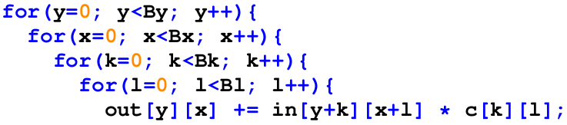
Is It Really That Easy ?
No, we forget a few things
Cache capacity and reuse distance
If caches were infinitely large, we would be finished
For deep loopnests analysis can be very difficult
It would be much better to automate these steps
We need more theory and tools
Cost models

Slide 34
Reuse distance
The number of unique accesses between a use and a reuse is defined as the reuse distance
[a[0] a[6] a[20] b[1] a[6] a[0]] R_{D} = 3
* C. Ding, Y. Zhong, Predicting Whole-Program Locality through Reuse Distance Analysis, PLDI (2003)
If fully associative cache with n=4 entries
Optimal least recently used replacement policy
Cache hit if R_{D} < n
Cache miss if R_{D} ≥ n
We can measure reuse distance with profiling tools:
Suggestions for Locality Optimization (SLO)
Beyls, K., D'Hollander, E. Refactoring for Data Locality, IEEE Computer Vol. 42, no. 2 2009
Notes:
Can be line adresses

Slide 35
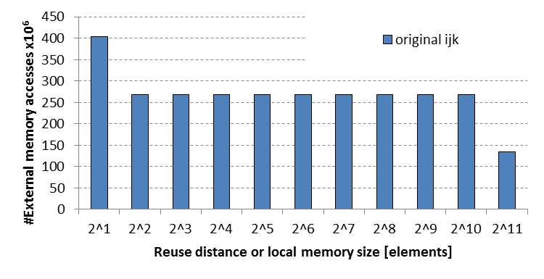
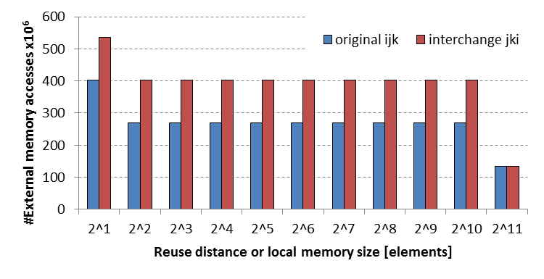
Study a matrix multiplication kernel
Loop interchange
for(i=0; i<Bi; i++){
for(j=0; j<Bj; j++){
for(k=0; k<Bk; k++){
C[i][j] += A[i][k] * B[k][j];
for(j=0; j<Bj; j++){
for(k=0; k<Bk; k++){
for(i=0; i<Bi; i++){
C[i][j] += A[i][k] * B[k][j];

Slide 36
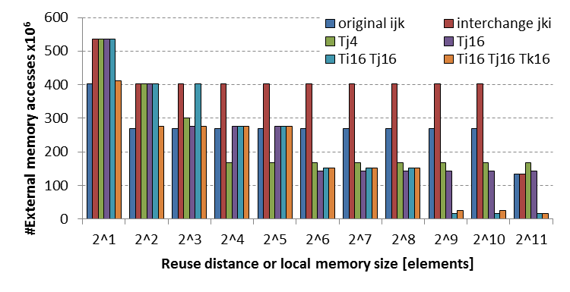
Loop tiling
Can be done in multiple dimensions
Manual exploration is intractable
for(i=0; i<Bi; i++){
for(j=0; j<Bj; j++){
for(k=0; k<Bk; k++){
C[i][j] += A[i][k] * B[k][j];
for(i=0; i<Bi; i++){
for(jj=0; jj<Bj; jj+=Tj){
for(k=0; k<Bk; k++){
for(j=jj; j<jj+Tj; j++)
C[i][j] += A[i][k] * B[k][j];

Slide 37

Automate the search
“Never send a human to do a machine’s job.” Agent Smith, The Matrix (1999)

Slide 38

A Practical Intermezzo
Accelerators for energy efficiency
Special Purpose HW
~100x better performance, 100x less energy than CPU
A simple processor for control
Multiple accelerators for heavy compute workload
Easy to develop with current HLS languages

Slide 39
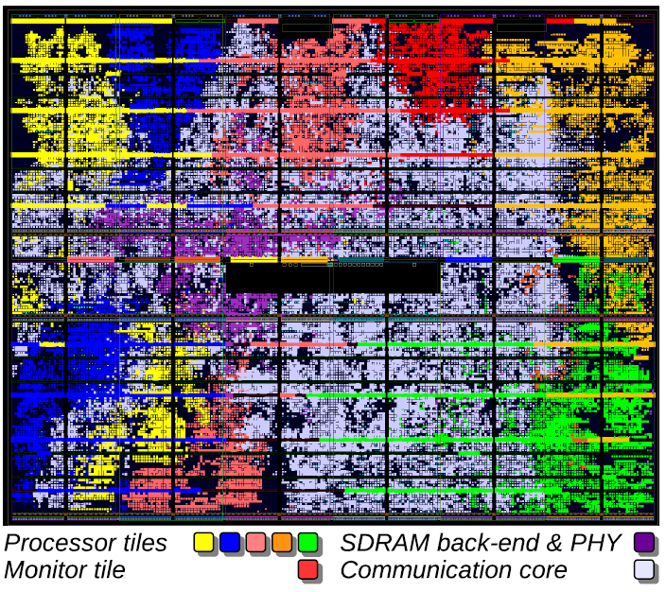
Bandwidth Hunger
Simple RISC core
Accelerator Operations
Interconnect Resources
Aethereal Interconnect 6 cores

Slide 40
What can we do?
Exploit the data reuse in accelerator workload
Use local buffers
Reduce communication with external memory

Slide 41
A Different Approach: Inter-Tile Reuse
But how about
DATA OVERLAP?
Accelerator workload is often static
We know the contents of the next tile
Optimize Iteration Order
Formulate the ordering as optimization problem

Slide 42
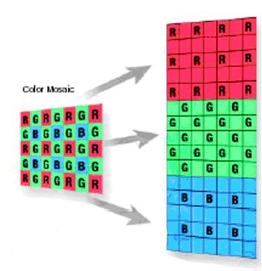
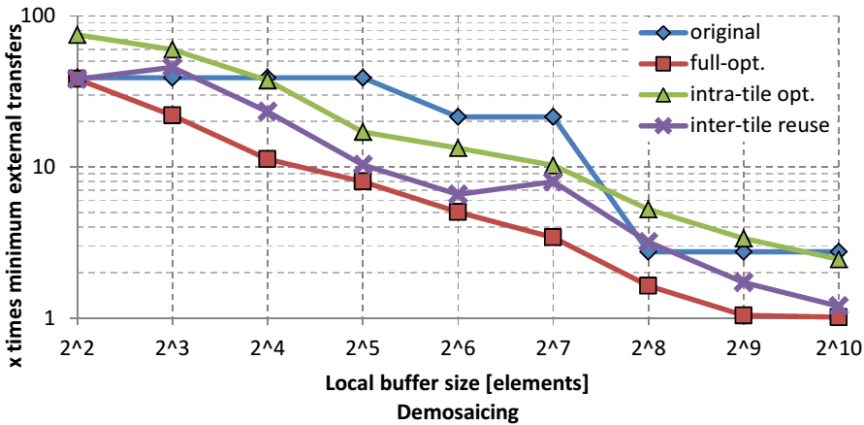
Demosaic Benchmark
Convert an 8 Mpix image: 0.6 GMAC
Intel-i7 0.56 s
ARM-A9 5.75 s
Microblaze 22.10 s
Accelerator 1.35 s @ 50 MB/s

Slide 43
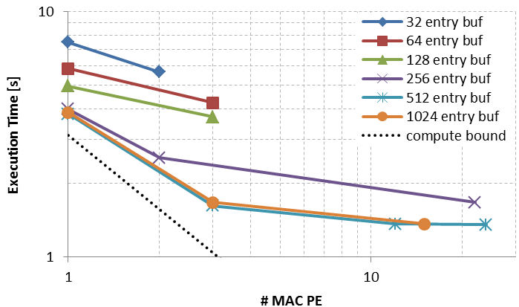
Demosaic Benchmark
Convert an 8 Mpix image: 0.6 GMAC
Intel-i7 0.56 s
ARM-A9 5.75 s
Microblaze 22.10 s
Accelerator 1.35 s @ 50 MB/s

Slide 44
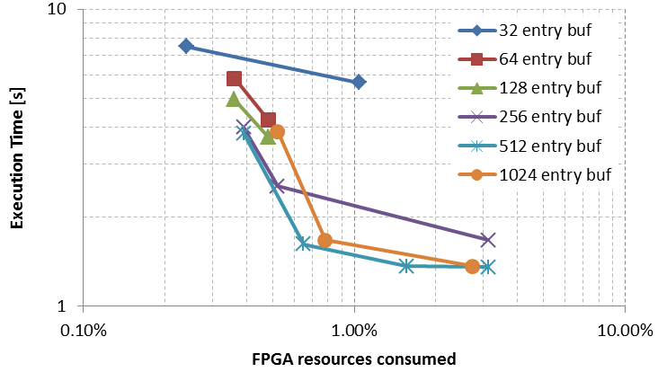
Demosaic Benchmark
Convert an 8 Mpix image: 0.6 GMAC
Intel-i7 0.56 s
ARM-A9 5.75 s
Microblaze 22.10 s
Accelerator 1.35 s @ 50 MB/s

Slide 45
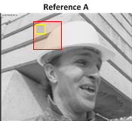
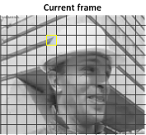
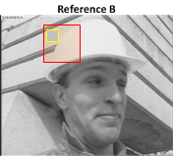



Motion Estimation
H264 video encoder ME ~ 30 Gops
for(frame){
for(macroblocks){
for(reference frame){
for(searchrange){
for(pixel){
SAD_operation();
for(find max){
Store vector();

Slide 46
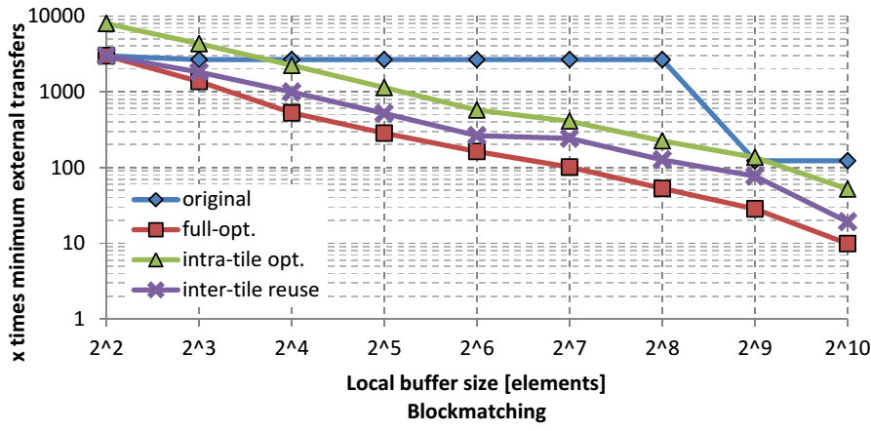
Block Matching
H264 video encoder ME ~ 30 Gops
Intel-i7 8.1 sec
ARM A9 72.3 sec
Microblaze 283.9 sec
Accelerator 3.4 sec @ 50MB/s

Slide 47
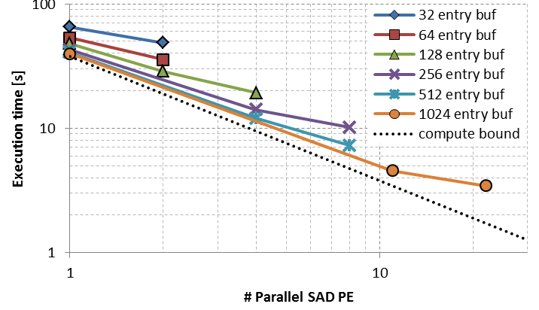
Block Matching
H264 video encoder ME ~ 30 Gops
Intel-i7 8.1 sec
ARM A9 72.3 sec
Microblaze 283.9 sec
Accelerator 3.4 sec @ 50MB/s

Slide 48

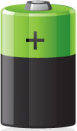
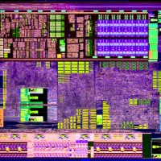

What do we achieve
Cost models

Slide 49
Loop Transformation Classes
Data-Flow-Based Transformations
Iteration Reordering Transformations
Loop Restructuring Transformations
Alter the form of the loop

Slide 50
Loop Unrolling
Duplicate loop body and adjus loop header
Increases ILP
Reduces loop overhead
Possibilities for common subexpression elimination
If partial unroll, loop should stay in original bound!
Downsides
Code size increases, can increase I-cache miss-rate
for(i=1; i<N-1; i+=2){
a[i]=a[i-1]+a[i]+a[i+1];
a[i+1]=a[i]+a[i+1]+a[i+2];
}
if(mod(N-1,2)==1){
a[N-1]=a[N-2]+a[N-1]+a[N];
for(i=1; i<N; i++){
a[i]=a[i-1]+a[i]+a[i+1];
}

Slide 51
Loop Merge or Fusion
Why?
Improve locality
Reduce loop overhead
for(i=0; i<N; i++){
b[i]=a[i]+1;
}
for(j=0; j<N; j++){
c[j]=b[j]+a[j];
}
for(i=0; i<N; i++){
b[i]=a[i]+1;
c[j]=b[j]+a[j];
}
Location
Location
Production/Consumption
Production/Consumption
Consumption(s)
Consumption(s)
Time
Time

Slide 52
Merging is not always allowed
Data dependencies from first to second loop
Allowed if
∀ I: cons(I) in loop 2 ≤ prod(I) in loop 1
Enablers: Bump, Reverse, Skew
for(i=0; i<N; i++){
b[i]=a[i]+1;
}
N-1>=i
for(i=0; i<N; i++){
c[i]=b[N-1]+a[i];
}
for(i=0; i<N; i++){
b[i]=a[i]+1;
}
i-2 < i
for(i=0; i<N; i++){
c[i]=b[i-2]+a[i];
}

Slide 53
Loop Bump: Example as enabler
for(i=2; i<N; i++){
b[i]=a[i]+1;
}
for(i=0; i<N-2; i++){
c[i]=b[i+2]*0.5;
}
i+2 > i => direct merging not possible
i+2-2 = i =>
possible to merge
for(i=2; i<N; i++){
b[i]=a[i]+1;
}
for(i=2; i<N; i++){
c[i-2]=b[i+2-2]*0.5;
}
for(i=2; i<N; i++){
b[i]=a[i]+1;
c[i-2]=b[i]*0.5;
}

Slide 54
Automatic frameworks
These are the tools to abstract away from code:
Model reuse (potential for locality)
Local iteration space
Transform loops to take advantage of reuse
Does this still give valid results?
Loop transformation theory
Iteration space
Dependence vectors
Unimodular transformations
Polyhedral Model

Slide 55
Tricks of the Trade: Main Take-Aways
Data-Flow-Based Transformations
Good compilers can help
Iteration Reordering Transformations
High-level transformations
Compilers are often not enough
Huge gains for parallelims and locality
Be carefull with dependencies
Loop Restructuring Transformations
Similar to reordering
Tools can help you: Check out SLO
Optimizing source to source compilers as well
If you have luck, these don’t support all constructions
Check out Polyhedral compilers, e.g. Pluto

Slide 56
Extra Enabler Transformations
Many of these can be very usefull
Especially to enable the bennificial ones:
Interchange
Tiling
Fusion
Often you need combinations to get the job done!
Make sure you can use them all for the:
Data Memory Management Assingment

Slide 57
Loop Extend
for I = exp₁ to exp₂
A(I)
exp₃ ≤ exp₁
exp₄ ≥ exp₂
⇒
for I = exp₃ to exp₄
if I≥exp₁ and I<exp₂
A(I)

Slide 58
Loop Extend: Example as enabler
for (i=0; i<N; i++)
B[i] = f(A[i]);
for (i=2; i<N+2; i++)
C[i-2] = g(B[i]);
for (i=0; i<N+2; i++)
if(i<N)
B[i] = f(A[i]);
for (i=0; i<N+2; i++)
if(i>=2)
C[i-2] = g(B[i]);
Loop Extend
⇒
for (i=0; i<N+2; i++)
if(i<N)
B[i] = f(A[i]);
if(i>=2)
C[i-2] = g(B[i]);
Loop Merge
⇒

Slide 59
Loop Reduce
for I = exp₁ to exp₂
if I≥exp₃ and I<exp₄
A(I)
⇒
for I = max(exp₁,exp₃) to
min(exp₂,exp₄)
A(I)

Slide 60
Loop Body Split
A(I) must be
single-assignment:
its elements should
be written once
for I = exp₁ to exp₂
A(I)
B(I)
for I_{a} = exp₁ to exp₂
A(I_{a})
for I_{b} = exp₁ to exp₂
B(I_{b})
⇒

Slide 61
Loop Body Split: Example as enabler
for (i=0; i<N; i++)
A[i] = f(A[i-1]);
B[i] = g(in[i]);
for (j=0; j<N; j++)
C[j] = h(B[j],A[N]);
⇒
Loop Body Split
for (i=0; i<N; i++)
A[i] = f(A[i-1]);
for (k=0; k<N; k++)
B[k] = g(in[k]);
for (j=0; j<N; j++)
C[j] = h(B[j],A[N]);
for (i=0; i<N; i++)
A[i] = f(A[i-1]);
for (j=0; j<N; j++)
B[j] = g(in[j]);
C[j] = h(B[j],A[N]);
⇒
Loop Merge

Slide 62
Loop Reverse
Location
Production
for I = exp₁ to exp₂
A(I)
Consumption
Time
for I = exp₂ downto exp₁
A(I)
Location
⇒
Or written differently:
for I = exp₁ to exp₂
A(exp₂-(I-exp₁))
Time

Slide 63
Loop Reverse: Satisfy dependencies
for (i=0; i<N; i++)
A[i] = f(A[i-1]);
No loop-carried dependencies allowed ! Can not reverse the loop
A[0] = …
for (i=1; i<=N; i++)
A[i]= A[i-1]+ f(…);
… = A[N] …
Enabler: data-flow transformations; exploit associativity of + operator
A[N] = …
for (i=N-1; i>=0; i--)
A[i]= A[i+1]+ f(…);
… = A[0] …

Slide 64
Loop Reverse: Example as enabler
for (i=0; i<=N; i++)
B[i] = f(A[i]);
for (i=0; i<=N; i++)
C[i] = g(B[N-i]);
N–i > i ⇒ merging not possible
Loop Reverse
for (i=0; i<=N; i++)
B[i] = f(A[i]);
for (i=0; i<=N; i++)
C[N-i] = g(B[N-(N-i)]);
⇒
N-(N-i) = i ⇒
merging possible
Loop Merge
⇒
for (i=0; i<=N; i++)
B[i] = f(A[i]);
C[N-i] = g(B[i]);

Slide 65
Loop Interchange
for I₁ = exp₁ to exp₂
for I₂ = exp₃ to exp₄
A(I₁, I₂)
⇒
for I₂ = exp₃ to exp₄
for I₁ = exp₁ to exp₂
A(I₁, I₂)

Slide 66
Loop Interchange: index traversal
j
j
Loop
Interchange
i
i
for(i=0; i<W; i++)
for(j=0; j<H; j++)
A[i][j] = …;
for(j=0; j<H; j++)
for(i=0; i<W; i++)
A[i][j] = …;

